Slide 1

Monte Carlo Simulation: Markov Property
MTH 564 – Mathematical Modeling

Slide 2
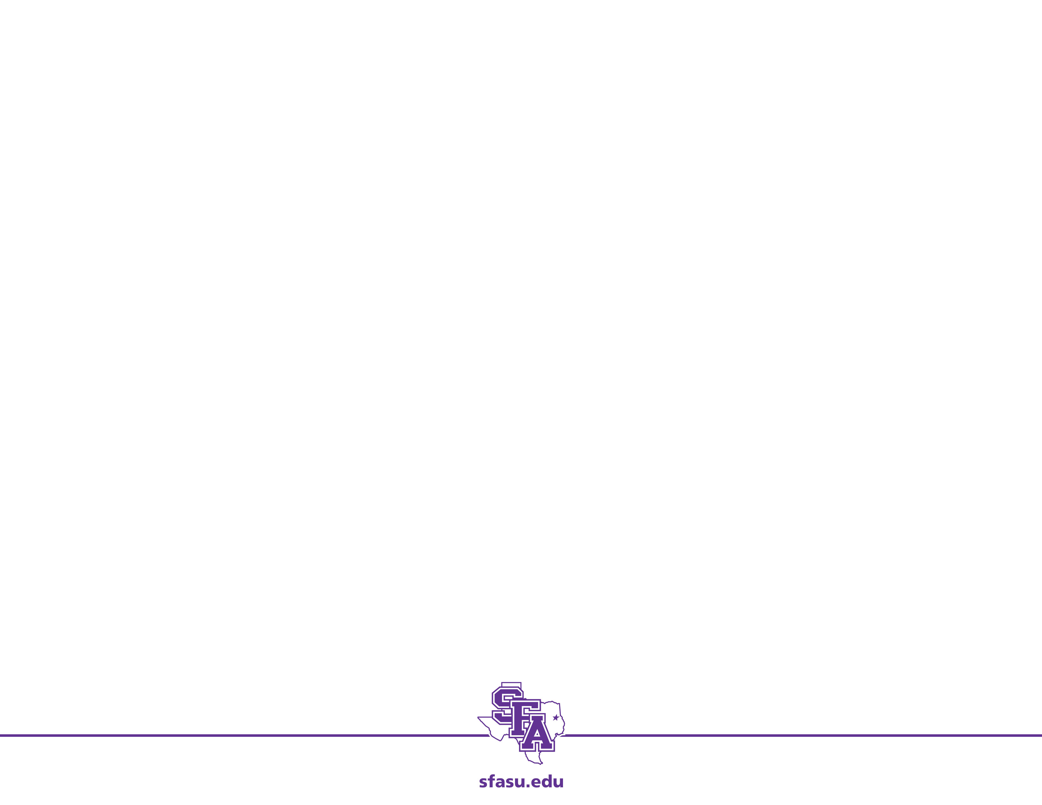
Overview
A stochastic process is said to have the Markov property if the information contained in the current state of the process is all that is needed to determine the probability distribution of future states.
Markov Chains and Markov Processes both have the Markov property, of course.
Simulation and Markov Property
The Markov Property makes the simulation of a stochastic process much simpler.
The quantity of data that needs to stored is greatly reduced because we only need to know the current state to determine the future state.

Slide 3
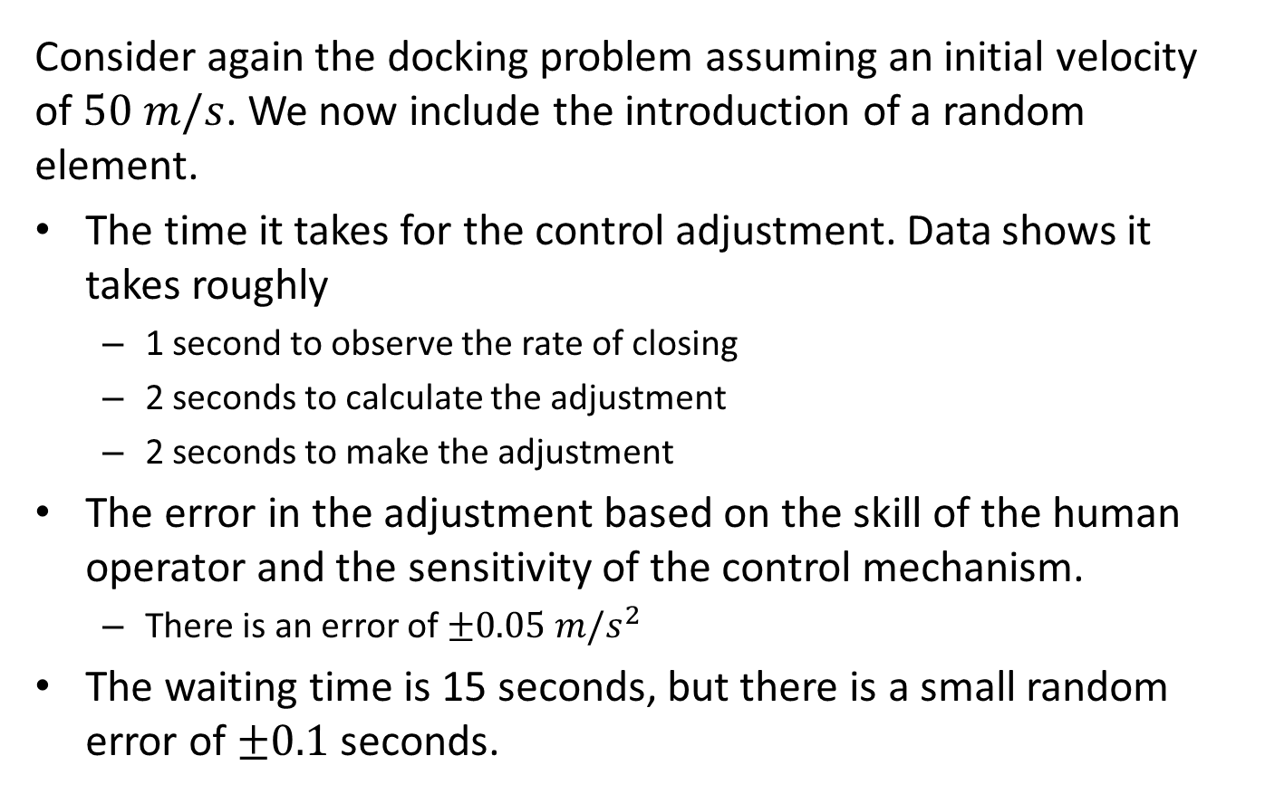
Problem: Astronauts (Again)
Consider again the docking problem assuming an initial velocity of $50 m/s$. We now include the introduction of a random element.
The time it takes for the control adjustment. Data shows it takes roughly
1 second to observe the rate of closing
2 seconds to calculate the adjustment
2 seconds to make the adjustment
The error in the adjustment based on the skill of the human operator and the sensitivity of the control mechanism.
There is an error of $±0.05 m/s^{2}$
The waiting time is 15 seconds, but there is a small random error of $±0.1$ seconds.

Slide 4
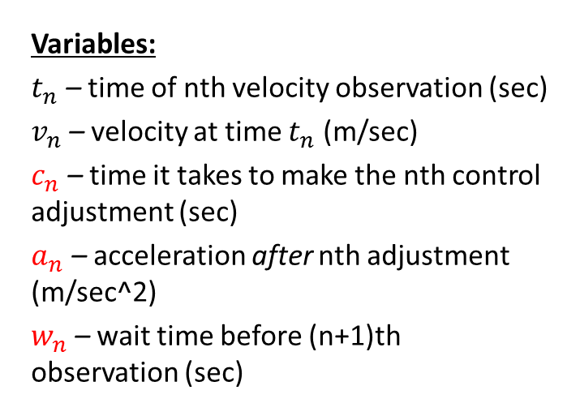
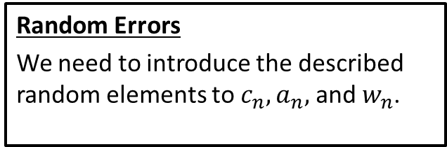
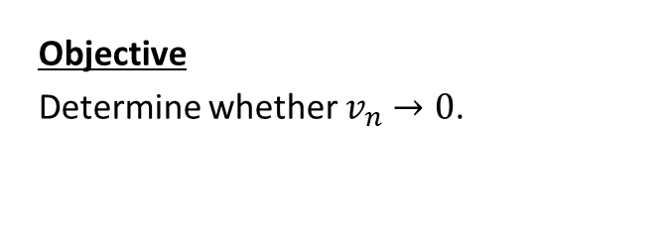
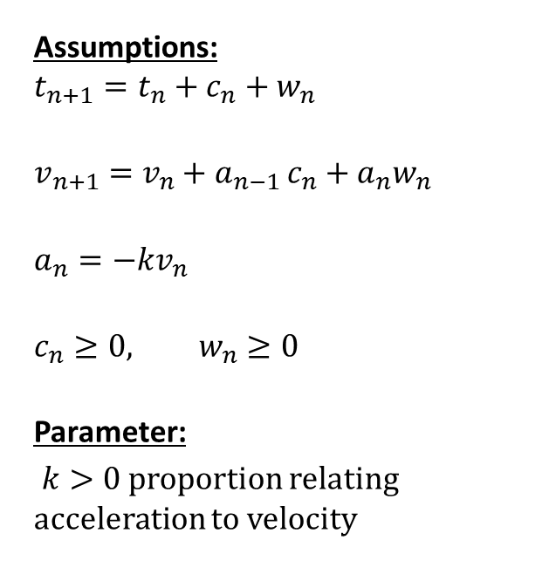
Step 1: Ask the question. (Previously)
Variables:
$t_{n}$ – time of nth velocity observation (sec)
$v_{n}$ – velocity at time $t_{n}$ (m/sec)
$c_{n}$ – time it takes to make the nth control adjustment (sec)
$a_{n}$ – acceleration after nth adjustment (m/sec^2)
$w_{n}$ – wait time before (n+1)th observation (sec)
Assumptions:
$$t_{n+1}=t_{n}+c_{n}+w_{n}$$
$$v_{n+1}=v_{n}+a_{n−1 }c_{n}+a_{n}w_{n}$$
$$a_{n}=−kv_{n}$$
$$c_{n}≥0, w_{n}≥0$$
Parameter:
$k>0$ proportion relating acceleration to velocity
Random Errors
We need to introduce the described random elements to $c_{n}, a_{n},$and $w_{n}$.
Objective
Determine whether $v_{n}→0$.

Slide 5
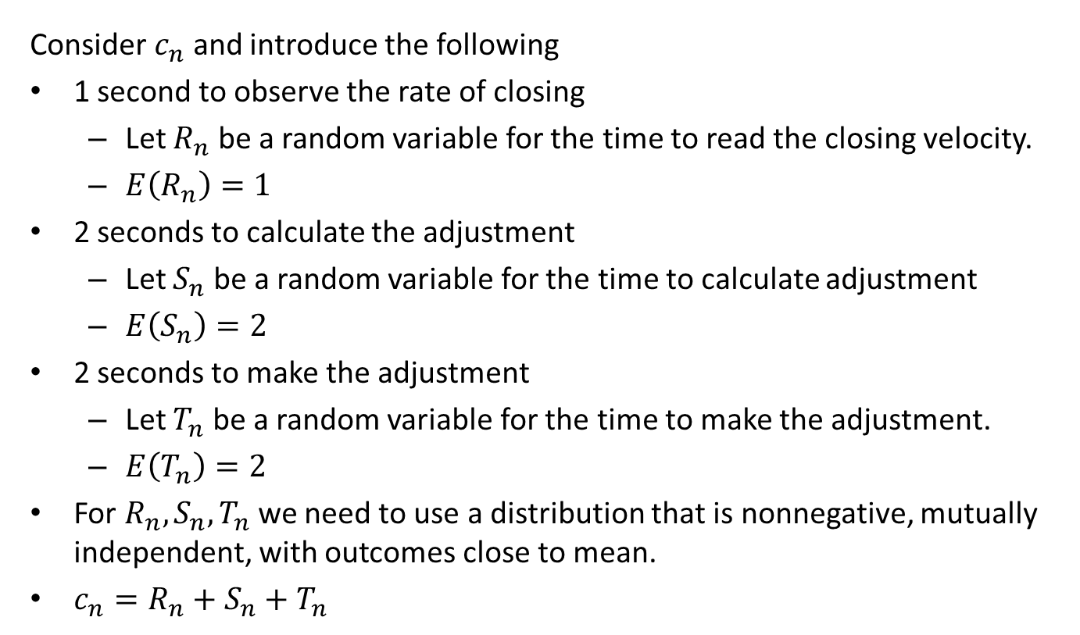
Introducing Random Elements
Consider $c_{n}$ and introduce the following
1 second to observe the rate of closing
Let $R_{n}$ be a random variable for the time to read the closing velocity.
$E\left(R_{n}\right)=1$
2 seconds to calculate the adjustment
Let $S_{n}$ be a random variable for the time to calculate adjustment
$E\left(S_{n}\right)=2$
2 seconds to make the adjustment
Let $T_{n}$ be a random variable for the time to make the adjustment.
$E\left(T_{n}\right)=2$
For $R_{n}, S_{n}, T_{n}$ we need to use a distribution that is nonnegative, mutually independent, with outcomes close to mean.
$c_{n}=R_{n}+S_{n}+T_{n}$

Slide 6
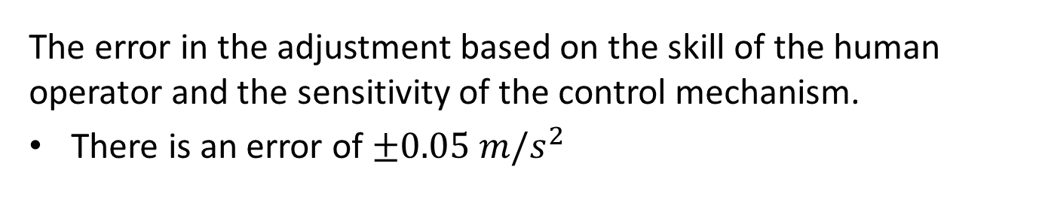
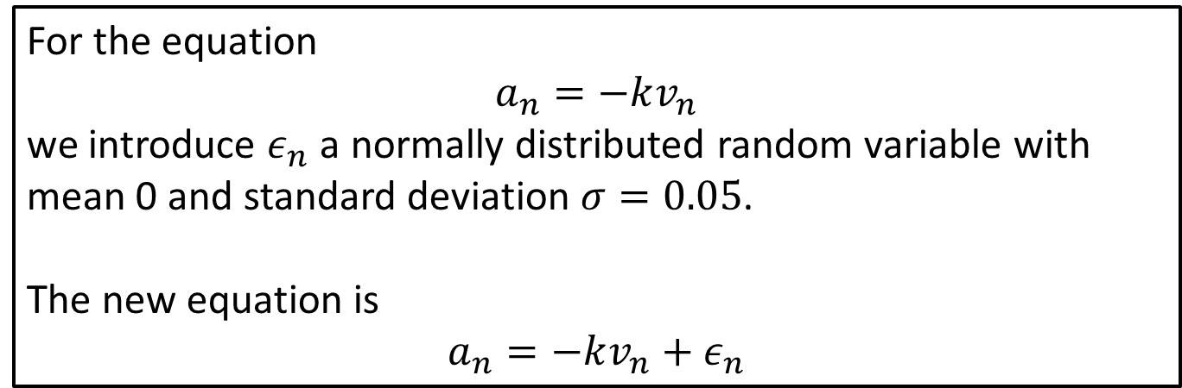
Introducing Random Elements
The error in the adjustment based on the skill of the human operator and the sensitivity of the control mechanism.
There is an error of $±0.05 m/s^{2}$
For the equation
$$a_{n}=−kv_{n}$$
we introduce $ε_{n}$ a normally distributed random variable with mean 0 and standard deviation $σ=0.05$.
The new equation is
$$a_{n}=−kv_{n}+ε_{n}$$

Slide 7

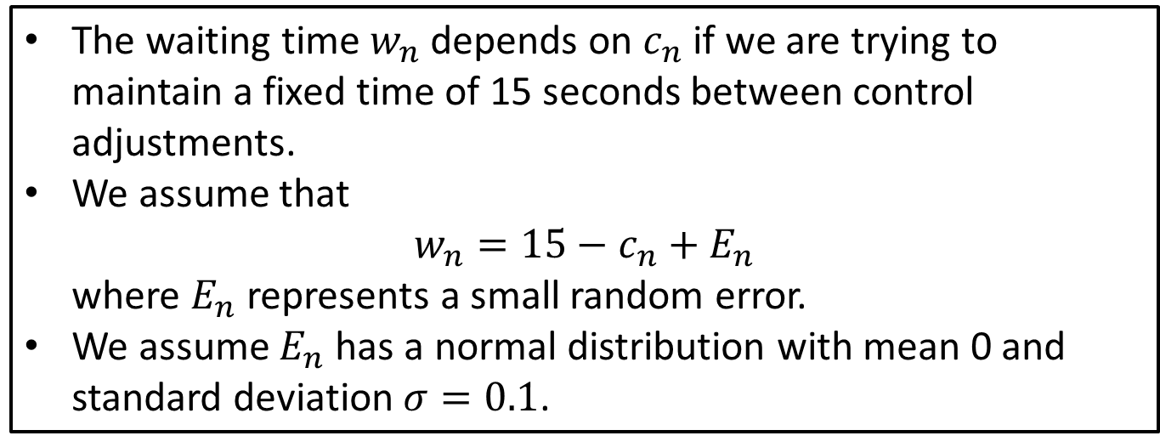
Introducing Random Elements
The waiting time is 15 seconds, but there is a small random error of $±0.1$ seconds.
The waiting time $w_{n}$ depends on $c_{n}$ if we are trying to maintain a fixed time of 15 seconds between control adjustments.
We assume that $w_{n}=15−c_{n}+E_{n}$ where $E_{n}$ represents a small random error.
We assume $E_{n}$ has a normal distribution with mean 0 and standard deviation $σ=0.1$.

Slide 8
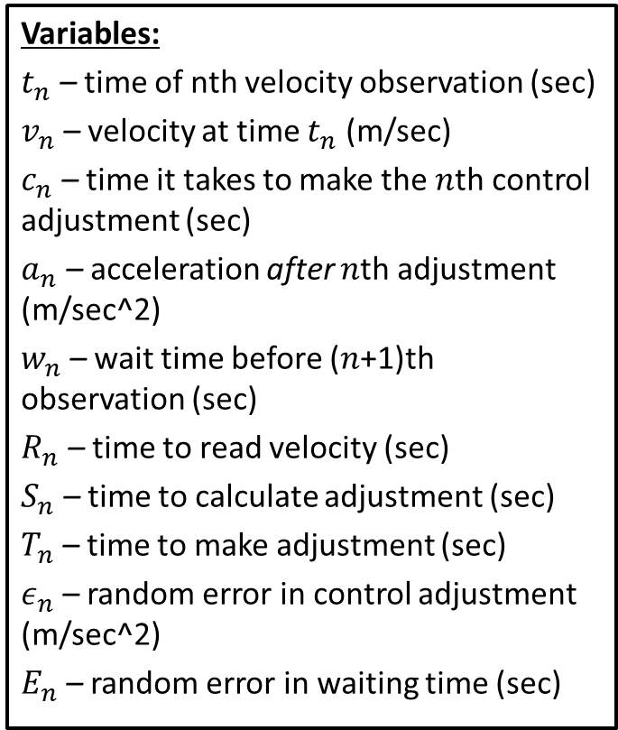
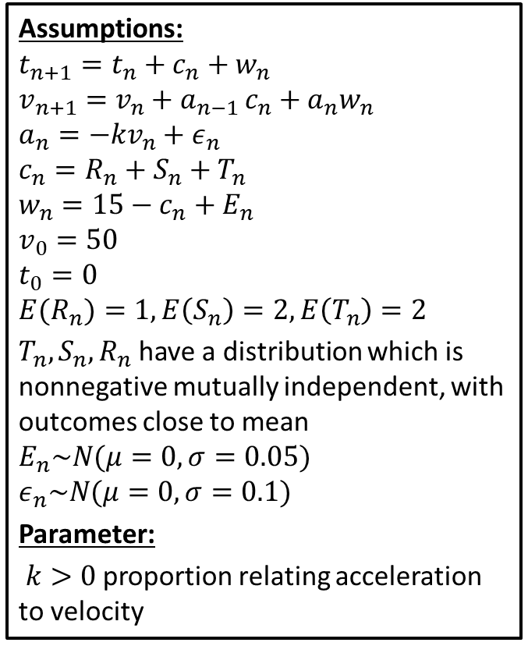
Step 1: Ask the question. (Improved)
Variables:
$t_{n}$ – time of nth velocity observation (sec)
$v_{n}$ – velocity at time $t_{n}$ (m/sec)
$c_{n}$ – time it takes to make the $n$th control adjustment (sec)
$a_{n}$ – acceleration after $n$th adjustment (m/sec^2)
$w_{n}$ – wait time before ($n$+1)th observation (sec)
$R_{n}$ – time to read velocity (sec)
$S_{n}$ – time to calculate adjustment (sec)
$T_{n}$ – time to make adjustment (sec)
$ε_{n}$ – random error in control adjustment (m/sec^2)
$E_{n}$ – random error in waiting time (sec)
Assumptions:
$$t_{n+1}=t_{n}+c_{n}+w_{n} \\ v_{n+1}=v_{n}+a_{n−1 }c_{n}+a_{n}w_{n} \\ a_{n}=−kv_{n}+ε_{n}$$
$$c_{n}=R_{n}+S_{n}+T_{n}$$
$$w_{n}=15−c_{n}+E_{n}$$
$$v_{0}=50$$
$$t_{0}=0$$
$${E(R}_{n})=1, E\left(S_{n}\right)=2, E\left(T_{n}\right)=2$$
$T_{n},S_{n},R_{n}$ have a distribution which is nonnegative mutually independent, with outcomes close to mean
$$E_{n}\sim N(μ=0, σ=0.05)$$
$$ε_{n}\sim N(μ=0, σ=0.1)$$
Parameter:
$k>0$ proportion relating acceleration to velocity

Slide 9
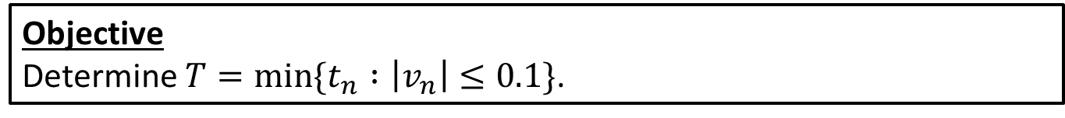
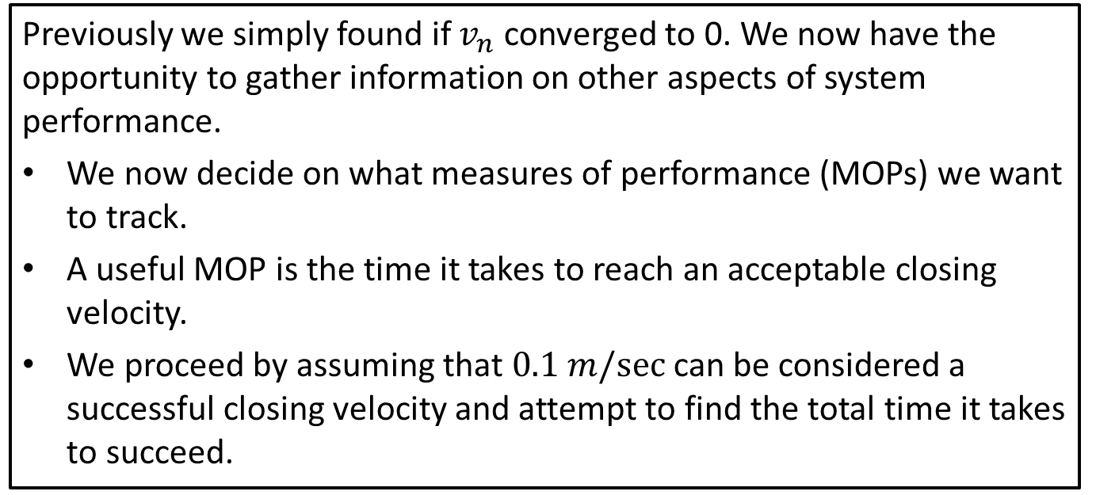
Step 1: Objective
Previously we simply found if $v_{n}$ converged to 0. We now have the opportunity to gather information on other aspects of system performance.
We now decide on what measures of performance (MOPs) we want to track.
A useful MOP is the time it takes to reach an acceptable closing velocity.
We proceed by assuming that $0.1 m/sec⁡$can be considered a successful closing velocity and attempt to find the total time it takes to succeed.
Objective
Determine $T=\min{\{t_{n} :\left|v_{n}\right|≤0.1\}}$.

Slide 10
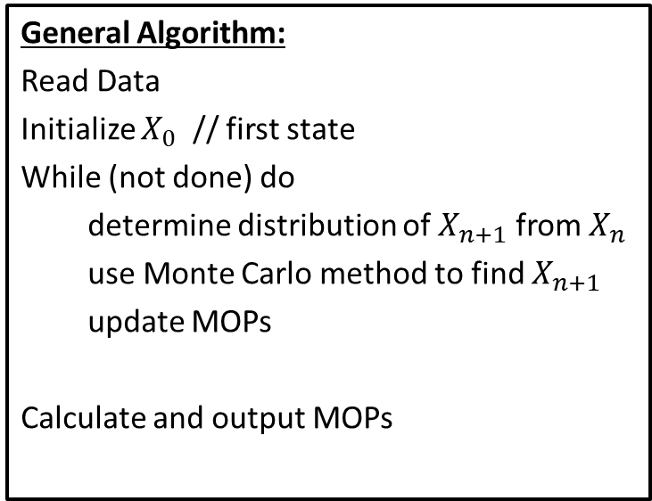
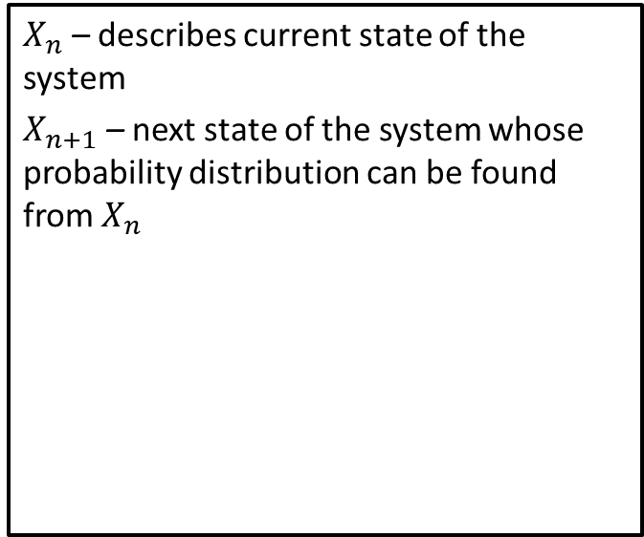
Step 2: Select the modeling approach
We use a Monte Carlo simulation based off the Markov property.
General Algorithm:
Read Data
Initialize $X_{0}$ // first state
While (not done) do
determine distribution of $X_{n+1}$ from $X_{n}$
use Monte Carlo method to find $X_{n+1}$
update MOPs
Calculate and output MOPs
$X_{n}$ – describes current state of the system
$X_{n+1}$ – next state of the system whose probability distribution can be found from $X_{n}$

Slide 11
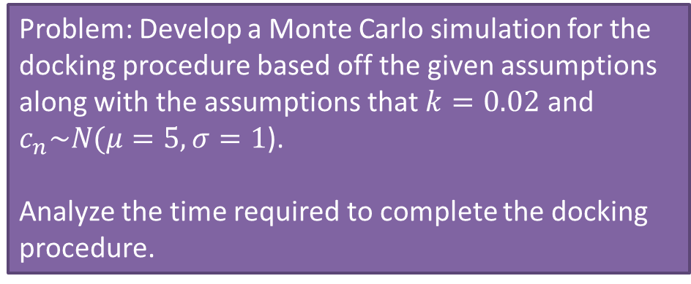
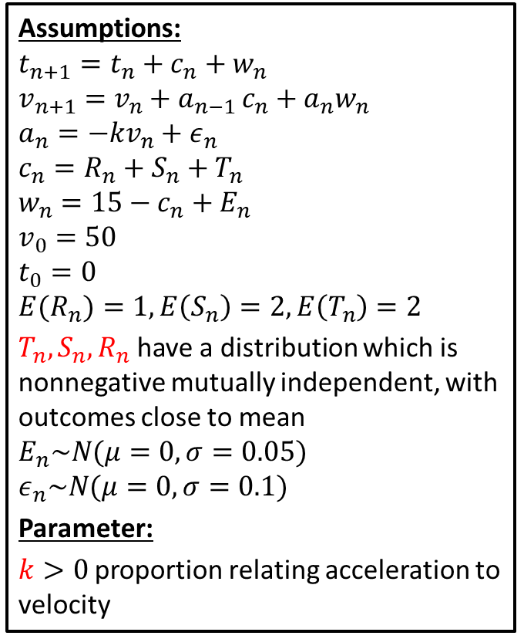
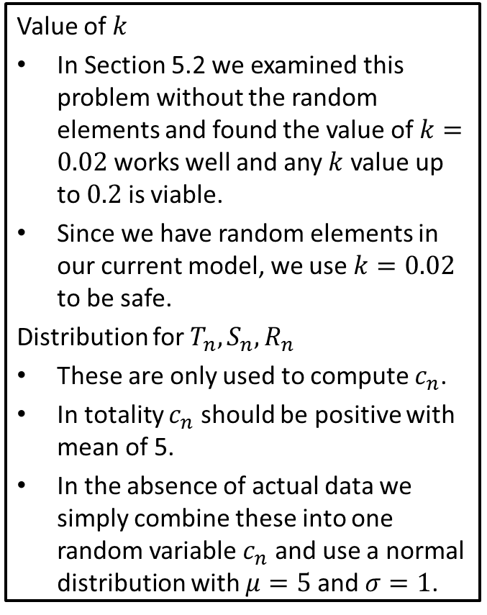
Step 3: Formulate the model (Decisions)
Value of $k$
In Section 5.2 we examined this problem without the random elements and found the value of $k=0.02$ works well and any $k$ value up to $0.2$ is viable.
Since we have random elements in our current model, we use $k=0.02$ to be safe.
Distribution for $T_{n}, S_{n}, R_{n}$
These are only used to compute $c_{n}$.
In totality $c_{n}$ should be positive with mean of 5.
In the absence of actual data we simply combine these into one random variable $c_{n}$ and use a normal distribution with $μ=5$ and $σ=1$.
Assumptions:
$$t_{n+1}=t_{n}+c_{n}+w_{n} \\ v_{n+1}=v_{n}+a_{n−1 }c_{n}+a_{n}w_{n} \\ a_{n}=−kv_{n}+ε_{n}$$
$$c_{n}=R_{n}+S_{n}+T_{n}$$
$$w_{n}=15−c_{n}+E_{n}$$
$$v_{0}=50$$
$$t_{0}=0$$
$${E(R}_{n})=1, E\left(S_{n}\right)=2, E\left(T_{n}\right)=2$$
$T_{n},S_{n},R_{n}$ have a distribution which is nonnegative mutually independent, with outcomes close to mean
$$E_{n}\sim N(μ=0, σ=0.05)$$
$$ε_{n}\sim N(μ=0, σ=0.1)$$
Parameter:
$k>0$ proportion relating acceleration to velocity
Problem: Develop a Monte Carlo simulation for the docking procedure based off the given assumptions along with the assumptions that $k=0.02$ and $c_{n}\sim N(μ=5, σ=1$).
Analyze the time required to complete the docking procedure.
Notes:
Technically the normal distribution is not nonegative, but since 0 is 5 std. devs. From the mean, it is practically positive.

Slide 12
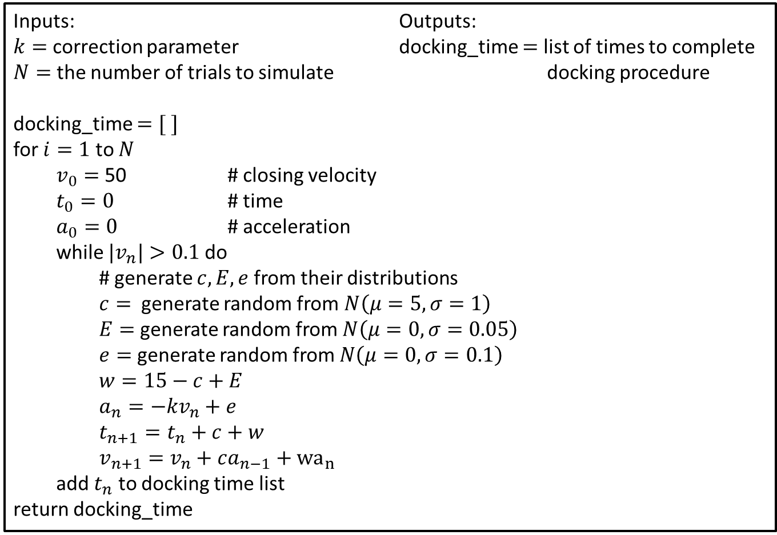
Step 4: Solve the Problem (Pseudo-Code)
Inputs: Outputs: $k=$ correction parameter docking_time $=$ list of times to complete $N=$ the number of trials to simulate docking procedure
docking_time $=[ ]$
for $i=1$ to $N$
$v_{0}=$ 50 # closing velocity
$t_{0}=0$ # time
$a_{0}=0$ # acceleration
while ${|v}_{n}|>0.1$ do
# generate $c,E,e$ from their distributions
$c=$ generate random from $N\left(μ=5, σ=1\right)$
$E=$ generate random from $N\left(μ=0, σ=0.05\right)$
$e=$ generate random from $N\left(μ=0, σ=0.1\right)$
$w=15−c+E$
$a_{n}=−kv_{n}+e$
$t_{n+1}=t_{n}+c+w$
$v_{n+1}=v_{n}+ca_{n−1}+{wa}_{n}$
add $t_{n}$ to docking time list
return docking_time
Notes:
See python file section1-1pig.py

Slide 13
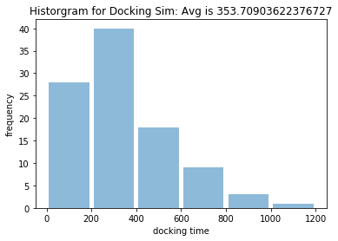
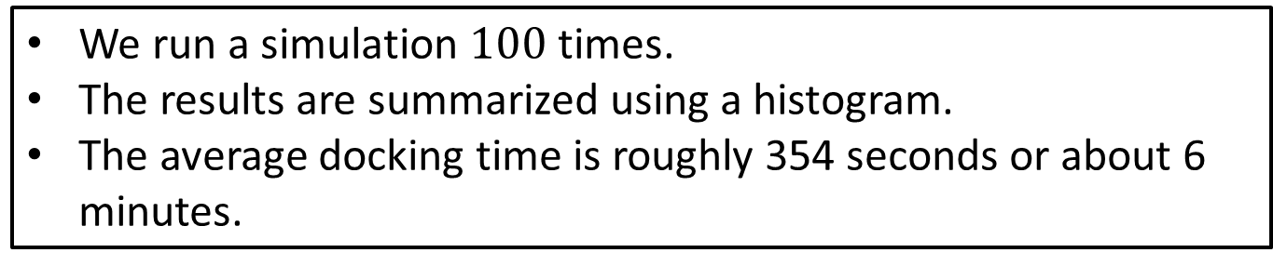
Step 4: Solve the Problem
We run a simulation $100$ times.
The results are summarized using a histogram.
The average docking time is roughly 354 seconds or about 6 minutes.
Notes:
See python file section1-1pig.py

Slide 14
Step 5: Answer the question
After 100 simulations of the docking procedure we arrived at the following results.
The average of the docking time turned out to be approximately 6 minutes.
Most of the docking procedures conclude between 0 and 600 seconds (10 minutes).
Some of the docking procedures took much longer though.
Notes:
See python file section1-1pig.py

Slide 15
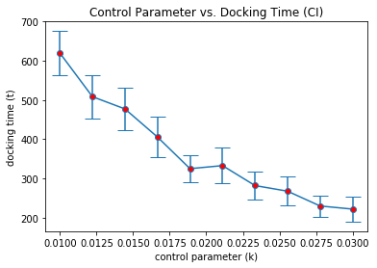
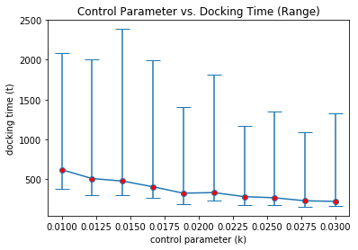
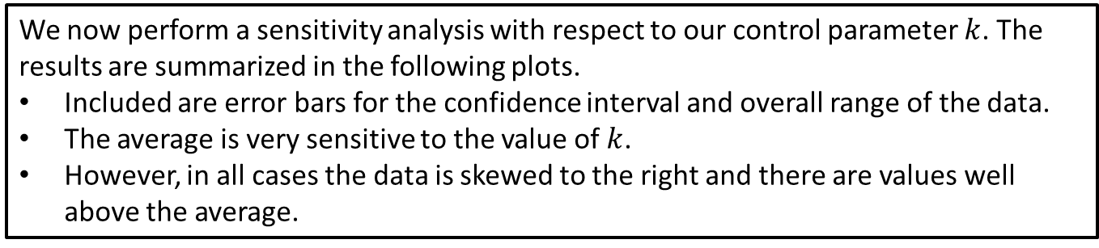

Sensitivity: Parameter $k$
We now perform a sensitivity analysis with respect to our control parameter $k$. The results are summarized in the following plots.
Included are error bars for the confidence interval and overall range of the data.
The average is very sensitive to the value of $k$.
However, in all cases the data is skewed to the right and there are values well above the average.
Notes:
See python file section1-1pig.py

Slide 16
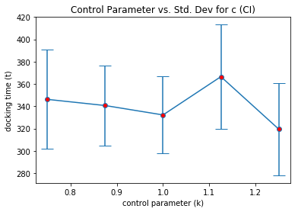
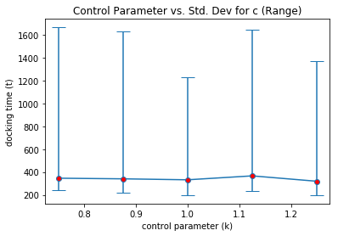
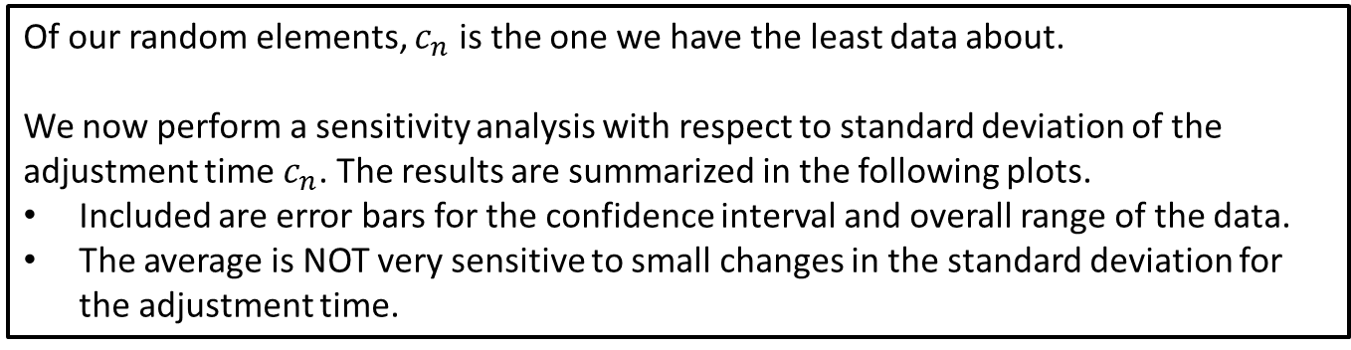

Sensitivity: Parameter $σ_{c}$
Of our random elements, $c_{n}$ is the one we have the least data about.
We now perform a sensitivity analysis with respect to standard deviation of the adjustment time $c_{n}$. The results are summarized in the following plots.
Included are error bars for the confidence interval and overall range of the data.
The average is NOT very sensitive to small changes in the standard deviation for the adjustment time.
Notes:
See python file section1-1pig.py

Slide 17
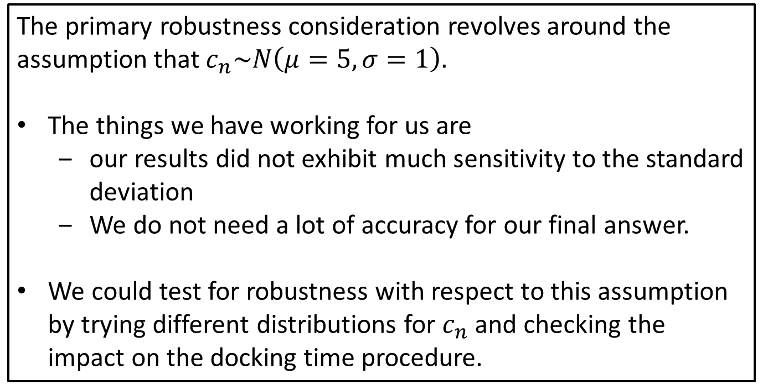
Robustness Considerations
The primary robustness consideration revolves around the assumption that $c_{n}\sim N\left(μ=5, σ=1\right).$
The things we have working for us are
our results did not exhibit much sensitivity to the standard deviation
We do not need a lot of accuracy for our final answer.
We could test for robustness with respect to this assumption by trying different distributions for $c_{n}$ and checking the impact on the docking time procedure.
Notes:
See python file section1-1pig.py

